Slide 1
Predicting Outcomes of Breast Cancer Patients
Urmee D., Chloe S., Anthony T., Chiemeka N., Maitrayee D.

Slide 2
Biological Background
Introduction to Invasive Lobular and Ductal Carcinoma and the genetic study involved

Slide 3
Breast Cancer Background

Slide 4
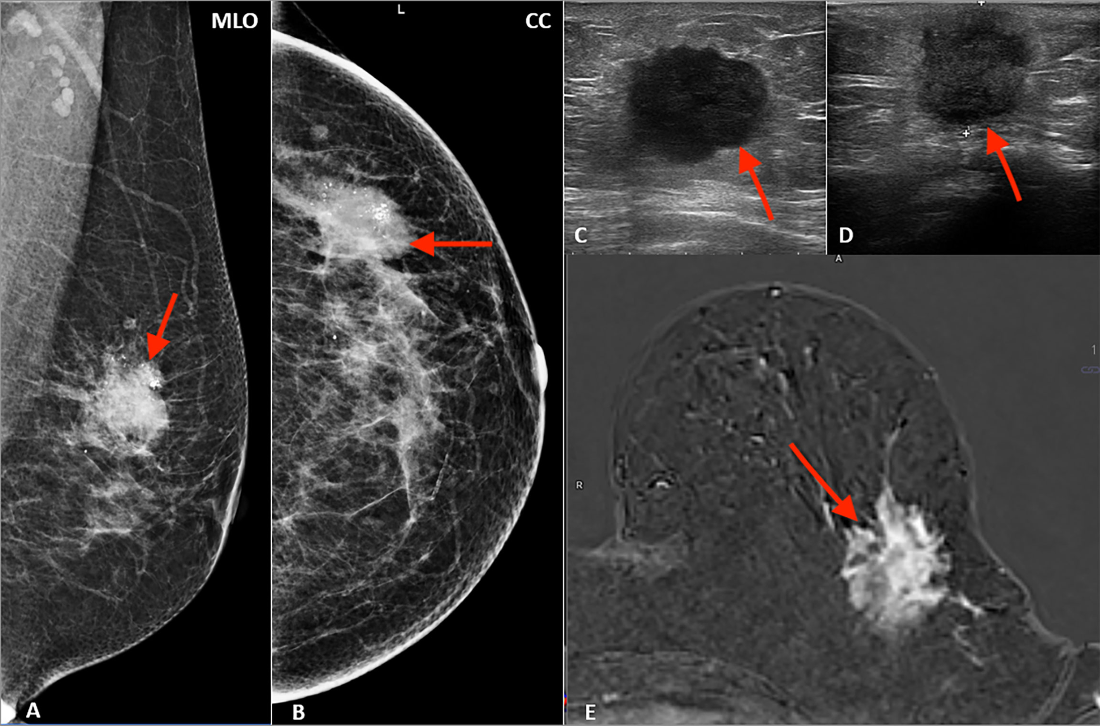
ILC and IDC Breast Cancer
More prevalent in females
In women with cancer, 1/3 are breast cancer
IDC: 1st most common
  75-80%
ILC: 2nd most common
  10-15%
Incidence rates have increased
>40,000 individuals die every year

Slide 5
Dataset Description

Slide 6
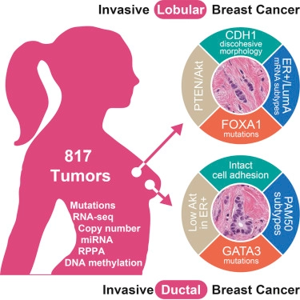
Dataset
705 breast cancer samples.
  611 patients survived, 94 died
Four different omics data types:
  cn: copy number variations (n=860)
  mu: mutations (n=249)
  rs: gene expression (n=604)
  pp: protein levels (n=223)
Notes:
Purpose… they aimed… (note to self-chloe)

Slide 7
Problem Description
Can ML techniques be used to accurately
predict patient outcomes based on omics data?

Slide 8
Data Exploration

Slide 9
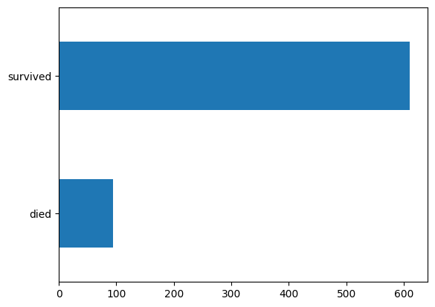
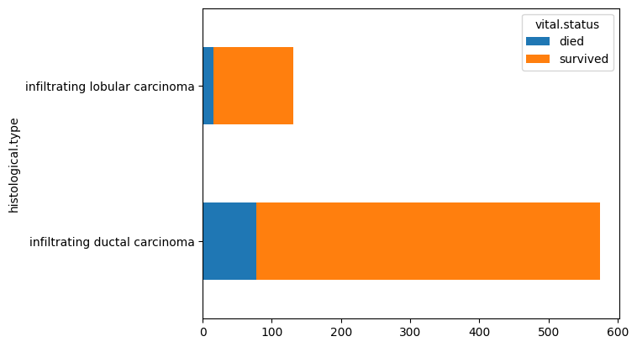
Distribution of class types: died vs. survived

Slide 10
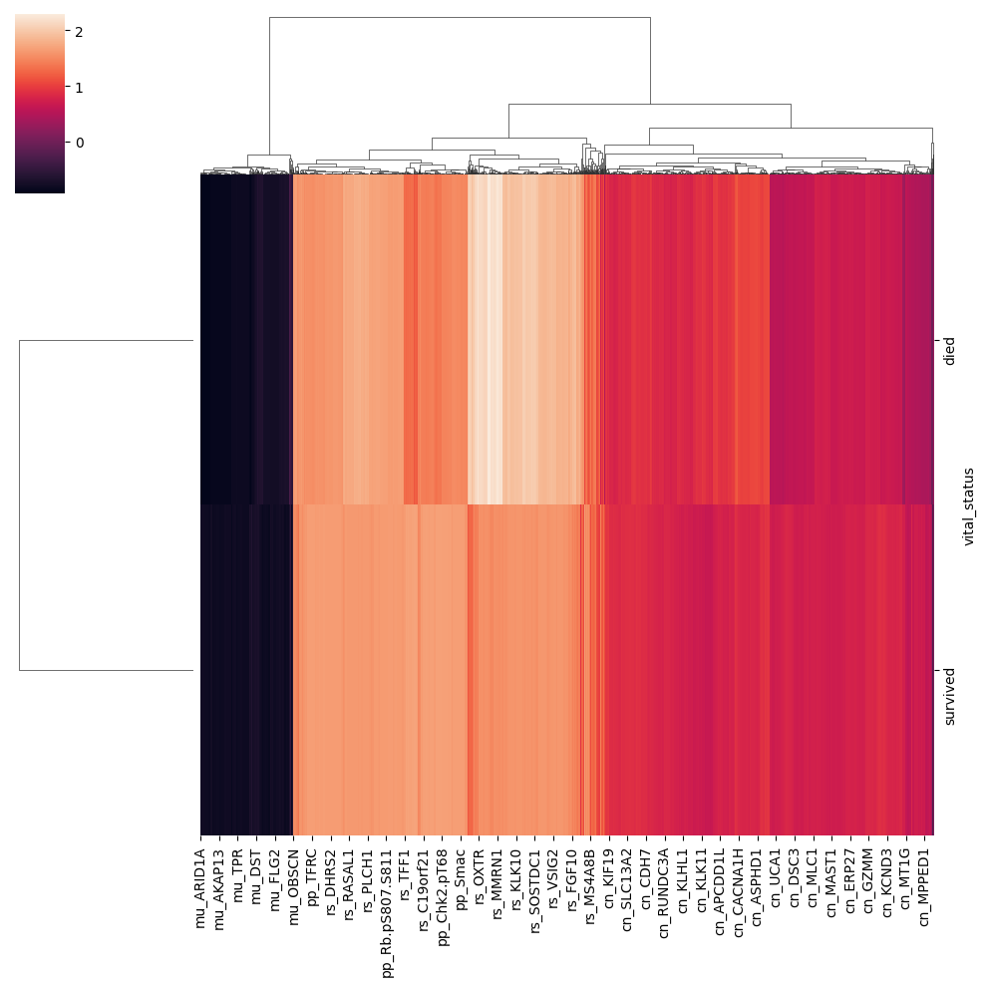
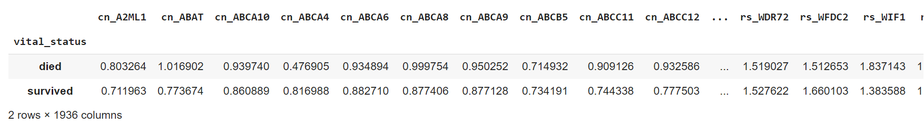
Cluster Performance

Slide 11
Quantile Normalization

Slide 12
What Is Quantile Normalization?
Quantile normalization is a technique for making two or more distributions identical in statistical properties.
Our quantile normalization procedure involves ranking the gene of each sample by magnitude, calculating the average value for the genes occupying the same rank, and then substituting the values of all the genes in that particular rank with this average value.
After the prior steps have been completed, the genes are reordered back into their original order.

Slide 13
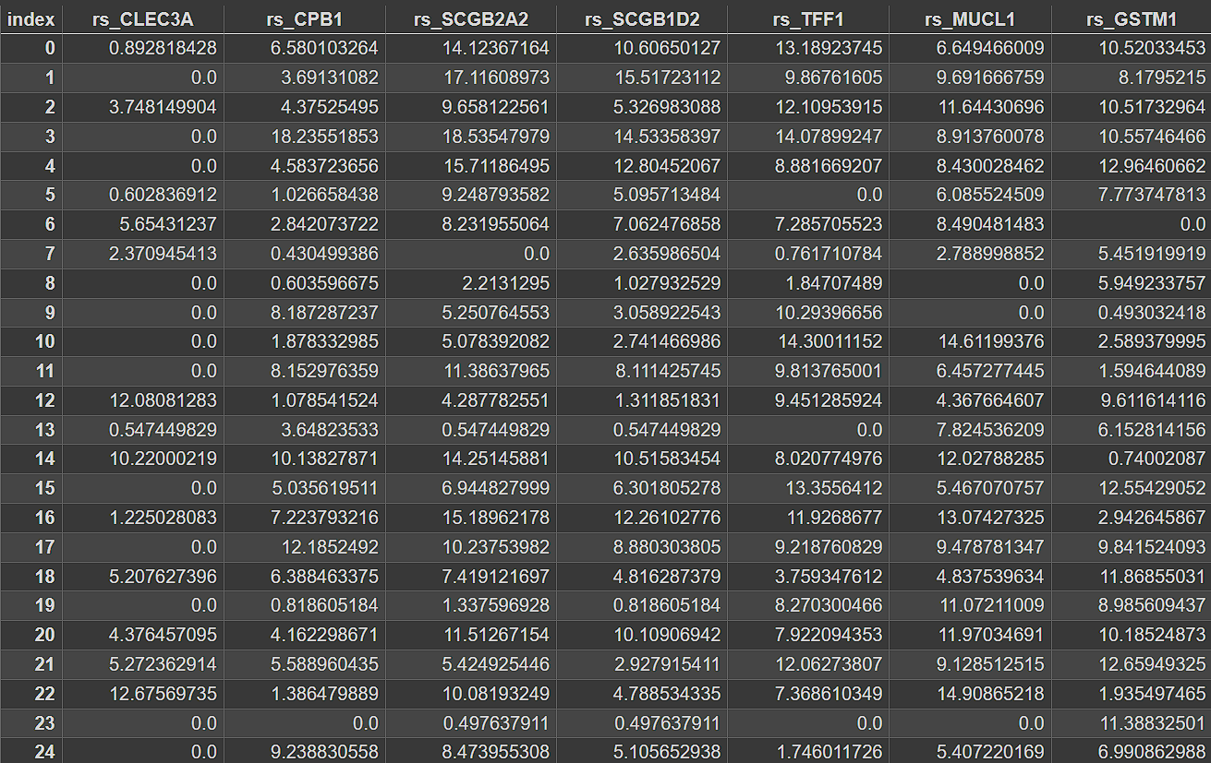
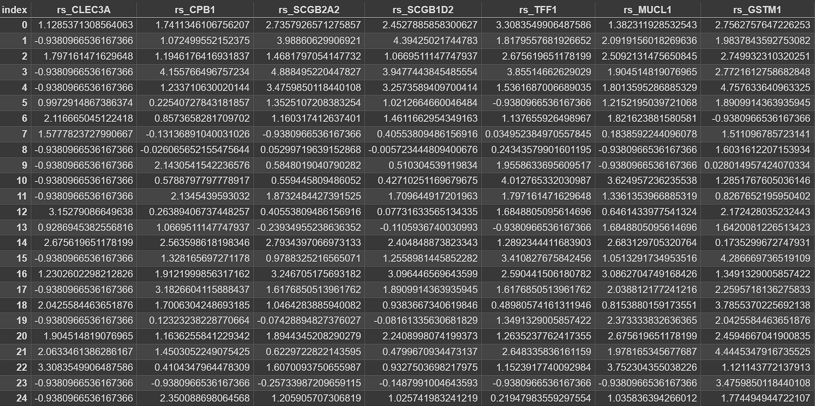
Quantile Normalization on the Dataset
Before quantile normalization:
After quantile normalization:

Slide 14
ML Classification
Divided data into 80/20 train/test split, using a random seed of 53
Used the quantile normalized omics columns as learning features, with the outcome feature (died/survived) as the target variable
Notes:
P true p
R sensitivity
F-1 precision and recall

Slide 15
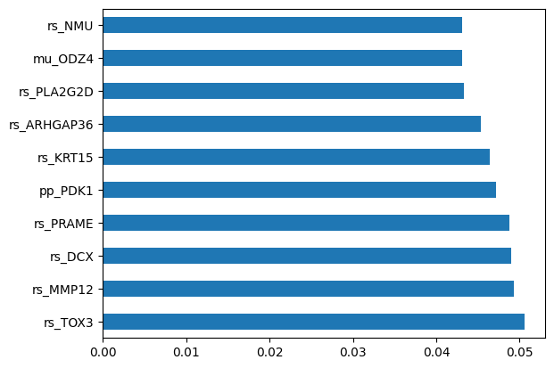
SVM Performance
Linear SVM
Most important predictive features:
  rs_TOX3
  rs_MMP12
  rs_DCX
Class | Precision | Recall | F-1 Score
Died | 0.266 | 0.285 | 0.275
Survived | 0.920 | 0.913 | 0.916

Slide 16
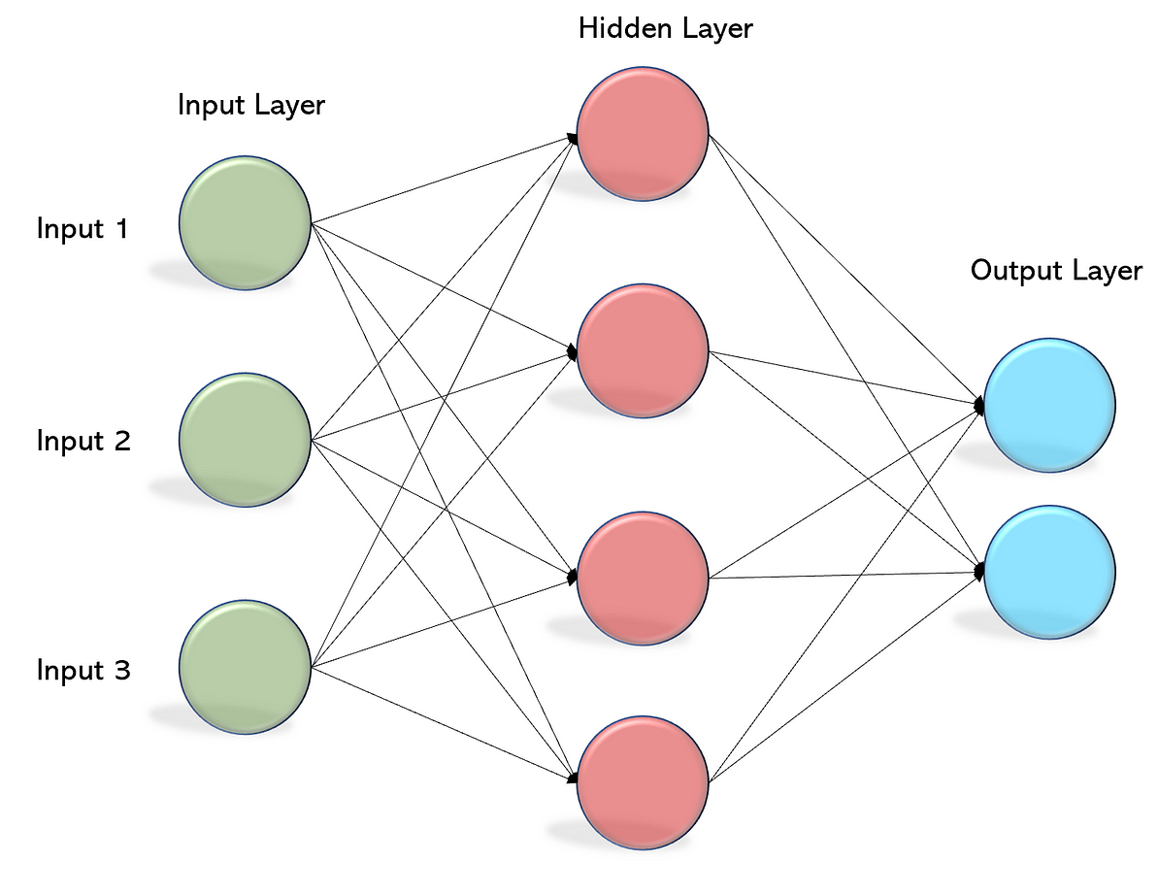
ANN Performance
Untuned ANN Performance
Class | Precision | Recall | F-1 Score
Died | 0.375 | 0.642 | 0.473
Survived | 0.957 | 0.881 | 0.918
Tuned ANN Performance - {'activation': 'tanh', 'alpha': 0.08, 'hidden_layer_sizes': (500, 500, 500), 'learning_rate': 'adaptive', 'solver': 'sgd'}
Class | Precision | Recall | F-1 Score
Died | 0.5 | 0.214 | 0.3
Survived | 0.918 | 0.976 | 0.946

Slide 17
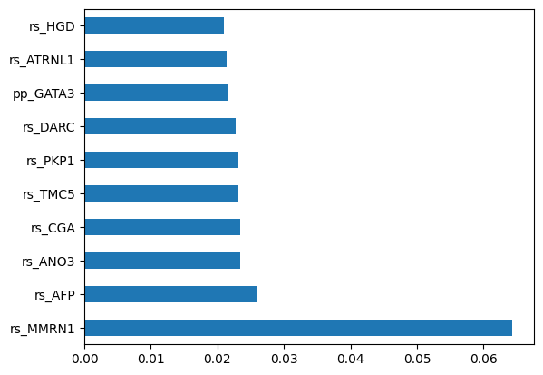
Decision Trees Performance
Max depth of 70, criterion is entropy
Most important predictive features:
  rs_MMRN1
  rs_AFP
  rs_ANO3
Class | Precision | Recall | F-1 Score
Died | 0.2 | 0.285 | 0.235
Survived | 0.917 | 0.874 | 0.895

Slide 18
KNN Performance
Naive Bayes Performance
Class | Precision | Recall | F-1 Score
Died | 0.0 | 0.0 | 0.0
Survived | 0.901 | 1.0 | 0.9478
Class | Precision | Recall | F-1 Score
Died | 0.375 | 0.643 | 0.474
Survived | 0.957 | 0.882 | 0.918

Slide 19
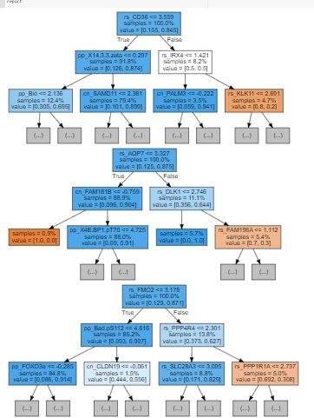
Random Forest Performance
Max Depth = 3
Class | Precision | Recall | F-1 Score
Died | 0.75 | 0.316 | 0.444
Survived | 0.923 | 0.987 | 0.954

Slide 20
Notes:
Bcause class imbalance, knn is worst, ann random forest dcent across,
Random not scale, intensive
Knn scale well, overfit

